Slide 1

Working With Data DATA9910
Week 6
Lucas Rizzo
email: lucas.rizzo@tudublin.ie

Slide 2
Indicative schedule
Week 1 | Set up environment and R notebook
Week 2 | Review Python and practice
Week 3 | Review R Importing data with R
Week 4 | Intro SQL and aggregate queries
Week 5 | Databases and scripting languages (To be submitted)
Week 6 | Interpreting Data (summary statistics, data visualisation)
Week 7 | Review week
Week 8 | Data manipulation in R Pandas and Numpy
Week 9 | Data visualisation in Python Data processing (regular expressions)
Week 10 | Audio data (R and tuneR) (To be submitted)
Week 11 | Image data (Python and skimage) (To be submitted)
Week 12 | Time series (Python and Pandas)
Week 13 | Working on Assignment Assignment deadline

Slide 3
Overview
How to use ggplot
Scatterplots
Boxplots
Bar Charts
Histograms
Saving Plots to external files

Slide 4
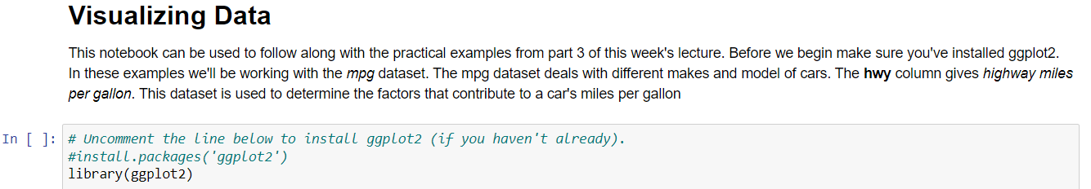
Before you start
Download the Visualizing Data Lecture Practical notebook
Start your jupyter notebook server
Follow along with the examples in today's lecture

Slide 5
Data visualisation
Graphs bring a huge amount of information instantaneously
They can be useful to identify trends and convey information
More like an art than a science. It requires a certain level of creativity even if you know all functions and its options
It will come with practice and looking at examples
Nice source of example examples: https://www.reddit.com/r/dataisbeautiful/
More focus on visualisation and not the statistical part

Slide 6
Dataset
?mpg
Fuel economy data from 1999 to 2008 for 38 popular models of cars
Basic checks
Run the first cell in the notebook and get some overview of the data.
How many records?
How many variables?

Slide 7
Dataset Intuitions
Before doing any in-depth exploration, try to think what do you expect from your dataset.
For example:
The displ variable measures the size of the engine in litres
The hwy variable measures the highway miles per gallon
What relationship do you expect to see between these two variables?
The bigger the size of the engine the ___ fuel efficient in terms of the number of miles per gallon

Slide 8
Dataset Intuitions
Before doing any in-depth exploration, try to think what do you expect from your dataset.
For example:
The displ variable measures the size of the engine in litres
The hwy variable measures the highway miles per gallon
What relationship do you expect to see between these two variables?
The bigger the size of the engine the less fuel efficient in terms of the number of miles per gallon

Slide 9
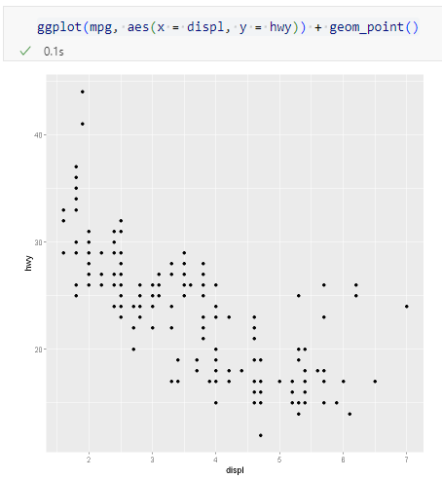
Visualising the Relationship
Using ggplot from ggplot2
Negative trend

Slide 10
Visualising the Relationship
geom_point(): This adds a scatter plot layer to the plot. It displays individual data points at the positions defined by the x and y aesthetics (in this case, displ and hwy). Each point represents a single observation in the dataset. We will see other layers in the next slides.
Using ggplot from ggplot2
Negative trend

Slide 11
Visualising the Relationship
What goes against the expectation?

Slide 12
Visualising the Relationship
What goes against the expectation?

Slide 13
Visualising the Relationship
Not all points conform to the trend e.g. the six points highlighted seem quite fuel efficient given the size of their engines.
This might give us something to investigate later on.

Slide 14
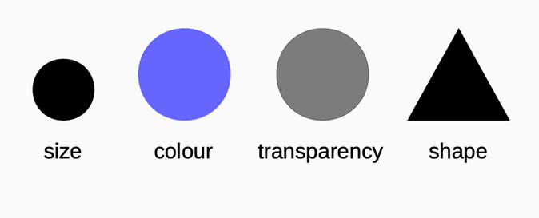
Aesthetics
To convey different information aesthetics can be used
Different visual characteristics can be mapped to data points

Slide 15
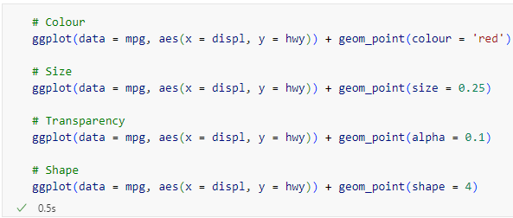
Aesthetics
To choose an aesthetic, i.e. to change a visual property of all the data.
Try the following examples in the notebook:

Slide 16

Aesthetics
Try the example below in the notebook and see what happens.
class

Slide 17
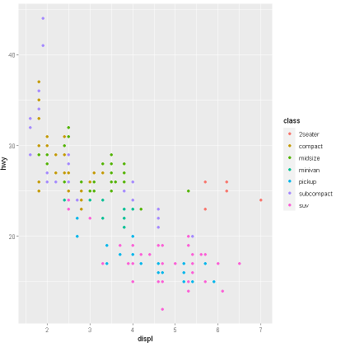

Aesthetics
It is more common to map an aesthetic to the values of a particular variable.
Check the outliers again =)
class

Slide 18
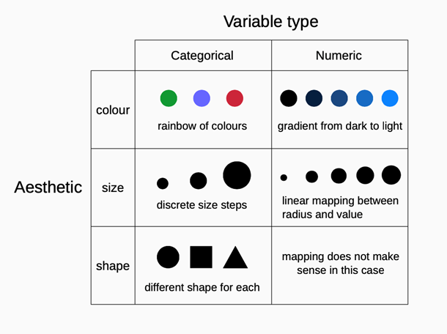
Aesthetics

Slide 19
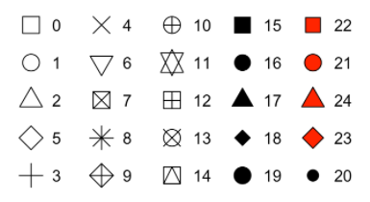
Aesthetics
R has 25 built in shapes that are identified by numbers

Slide 20
Facets
A grid of smaller plots that display different subsets of the data. Particularly useful for categorical data.
Useful for displaying conditional relationships.
We did the same when displaying the car class with different colors. But what if we want to convey more information?
Suitable for dividing up large amounts of data.

Slide 21
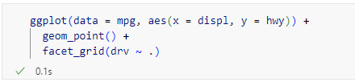
Facets - Syntax
Facets are also added to a plot using the + operator.
rows and cols represent the variables to put in the rows and columns of the grid.
~ is a symbol for the formula data type. You can read it as “depends on.”
The dot symbol can be used if omitting a dimension e.g “drv ~ .” puts only rows of the variable drv in the grid.

Slide 22
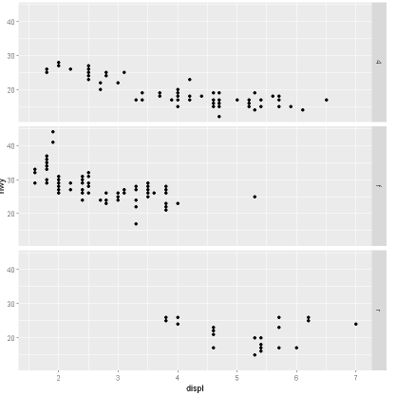
Grids with Rows

Slide 23
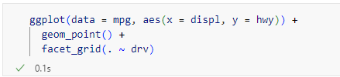
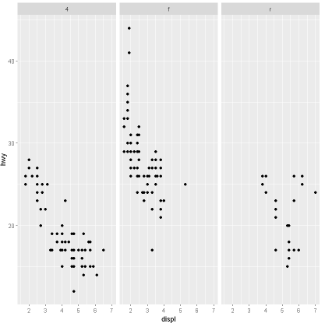
Grids with Columns

Slide 24
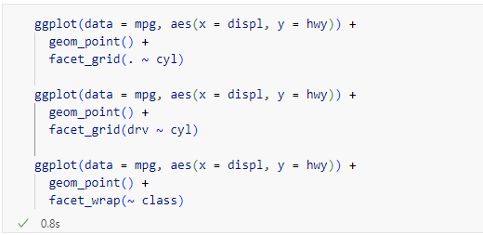
Task 1
Try each of the following 3 examples

Slide 25

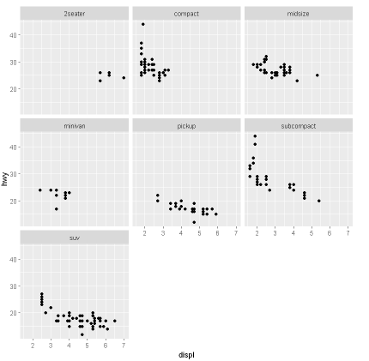
Using Facet Wrap
Facet wraps are useful to plot a symmetrical matrix of a single variable

Slide 26
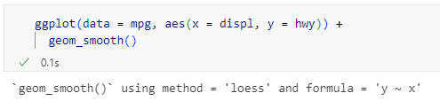
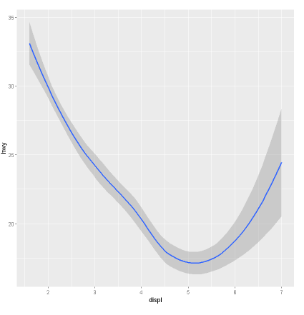
Smoothing
A smooth curve can be fitted to the points instead by using the smooth geom.
The warning tells us that default values are being used.
The gray area, by default, is the 95% confidence level interval for predictions from a linear model

Slide 27
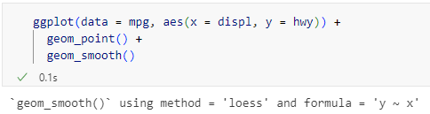
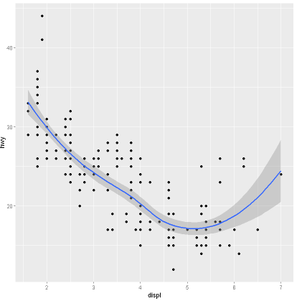
Multiple Geoms
Chart types may be overlaid by adding the geom names to a vector
The dots help us to understand the gray area.

Slide 28
Task 2 – Exploring Geoms
How would you replace the following scatterplot with one containing boxplots?
ggplot(data = mpg, aex(x = class, y = hwy))
Tips in the next slide...

Slide 29

Task 2 - Tips
Use the help function to look up the ggplot2 documentation and see all the “geom_” options

Slide 30
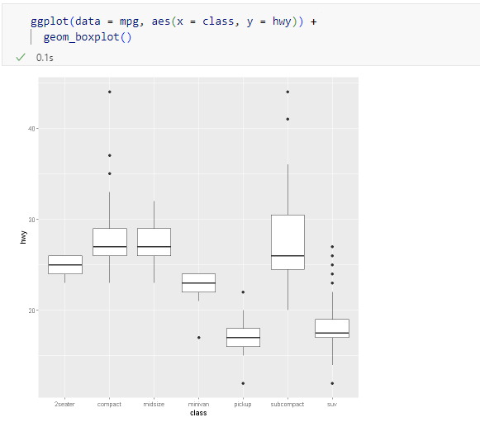
Task 2 - Answer

Slide 31
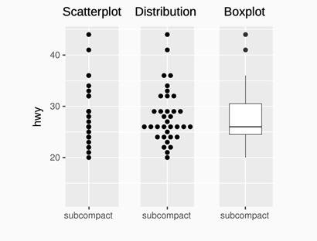
Boxplot
A scatterplot of a categorical variable is often not ideal, as the true distribution of points can be hidden (all points in the same x value). The boxplot addresses this issue.

Slide 32
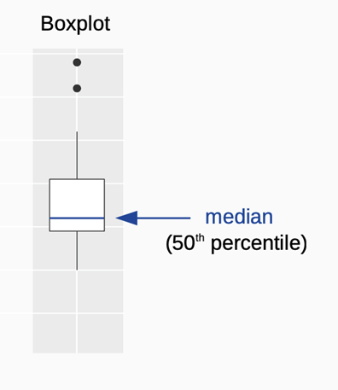
Anatomy of a Boxplot
Lots of information in a small representation
The median value is shown by a horizontal bar in the box of the boxplot

Slide 33
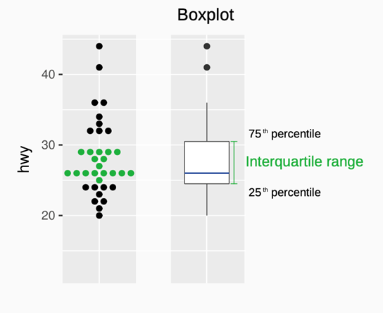
Anatomy of a Boxplot
The interquartile range (IQR) represents the numbers that are above the lowest 25% and below the top 25% i.e. the common values

Slide 34
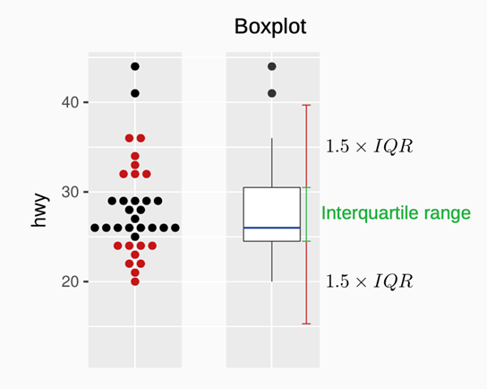
Anatomy of a Boxplot
The vertical lines of the boxplot (whiskers) delimit the typical values i.e. those within the range of 1.5 times the IQR from the box edges. Points lying outside these bounds are depicted as outliers
In this case, there were not enough values to draw the whole line.

Slide 35


Reordering
We can examine the values of a factor with the levels function
The reorder function reorders its first argument based on the mean values of a second variable, usually numeric.
Class with the lowest mean hwy
Class with the highest mean hwy

Slide 36
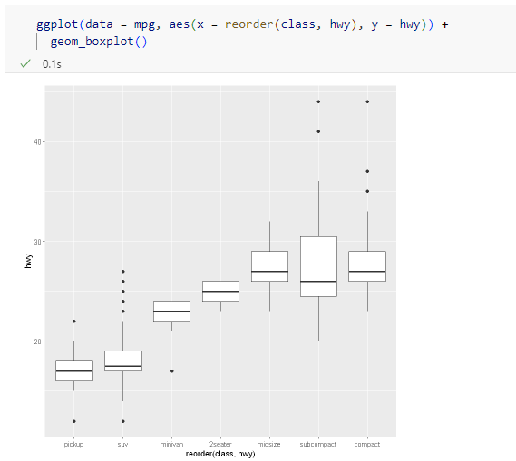
Reordering
Useful for plotting boxplots in a nice order

Slide 37
Task 3: Reordering by Median
Read the help page for the function reorder, here are some tips:
scan page for relevant info.
ignore things that don’t make sense.
try out examples.
Redraw the previous plot with the variable class ordered by the median of hwy.
Answer in the next slide...

Slide 38
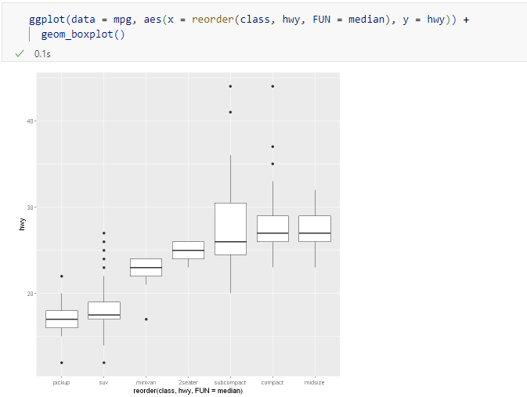
Task 3 - Answer

Slide 39
Diamond Dataset
Let’s use a different dataset to explore more visualisation with ggplot
The diamond dataset contains 53940 records with values for 10 variables including price. These variables may be divided into roughly two groups.
The four Cs
carat - a unit of mass equal to 200 mg.
clarity - measures internal characteristics and surface defects.
colour - a perfect diamond is transparent with no hue, or colour.
cut - cut is always king!
Dimensions
The x, y and z variables represent physical dimensions of a diamond

Slide 40
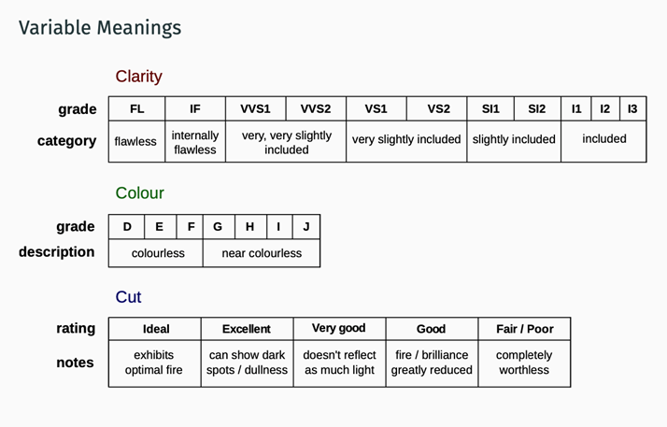
Variable Meanings

Slide 41
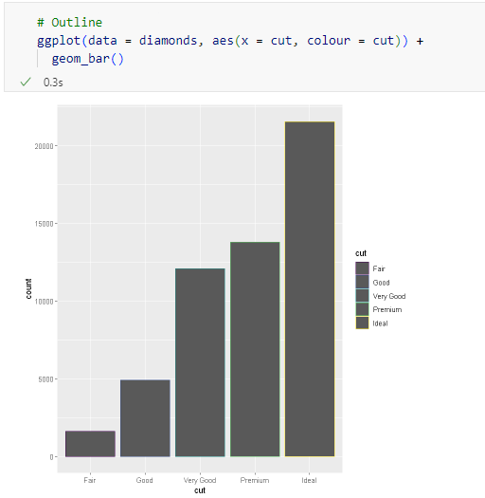
Bar Chart
For a bar chart, the colour attributes affects the outline of the bars
Displayed in order of cut quality (nice when there is an order)

Slide 42
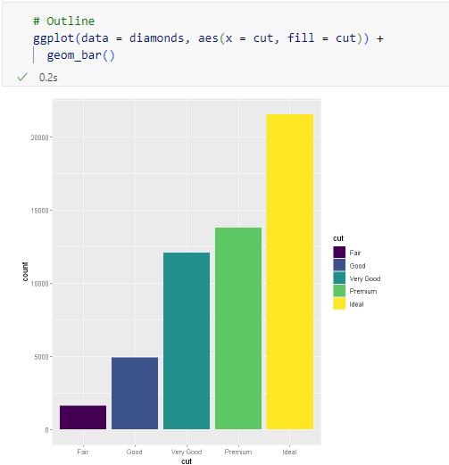
Bar Chart
The fill attribute can be used to colour the actual bars.
Easier to read than just changing the outline

Slide 43
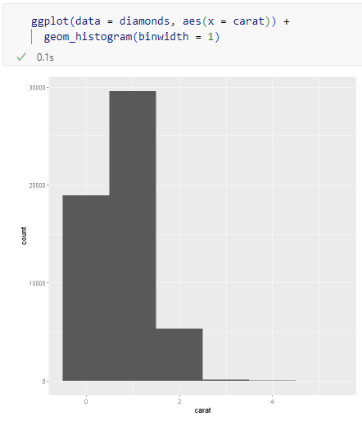
Histogram
Frequency of data of a single variable.
Used to identify the distribution of a variable.
Very quick visual description of the location of data

Slide 44
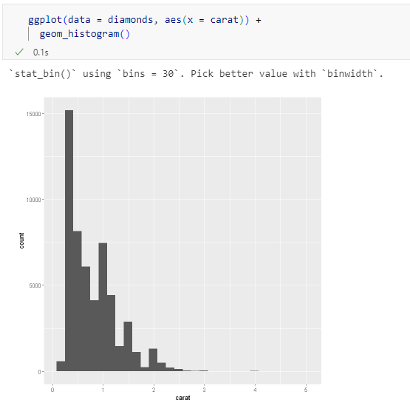
Default Histogram

Slide 45
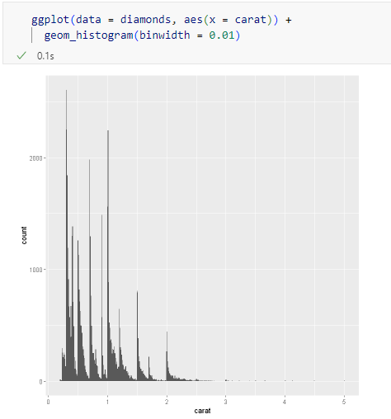
Histogram Bin Width
Very small bin width
Not possible to identify any trends anymore.
A good bin should help you identify trends in the data.

Slide 46

Saving Plots to File
To save a plot to the hard drive, use the ggsave function.
This command will save the last plotted graph to the current working directory in a png file named myGraph.png
To customise the size of the graph, set the width and height arguments.
Note: the dimensions are in inches

Slide 47
Task 4 – Finding a Suitable Binwidth
Experiment with different bin-widths until you find one that is suitable for the histogram
Save your output using ggsave

Slide 48
Summary
How to use ggplot to quickly generate graphs
The Language of ggplot: aesthetics, facets, geoms
Scatterplots: Smoothing and multiple geoms
Boxplots: how to interpret, ordering boxplots using levels
Bar Charts: Using colour and fill
Histograms: How to interpret, finding the right bin-width
Saving Plots: ggsave

Slide 49
Questions?

Slide 50
Lab
R Lab in Brightspace

